Slide 1
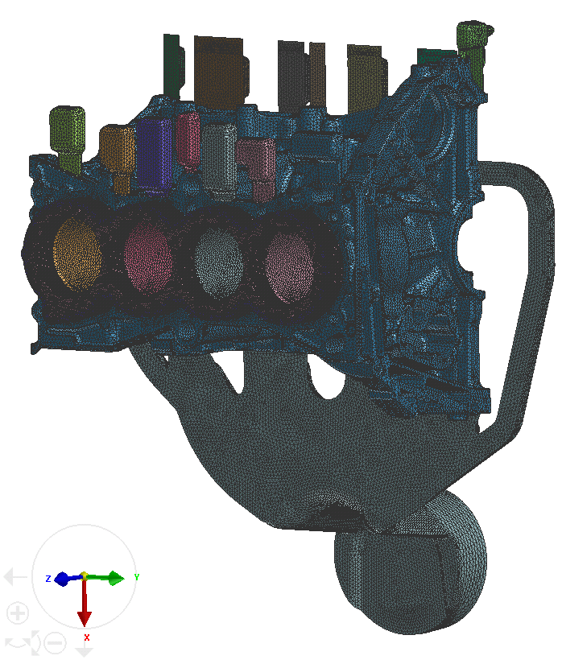
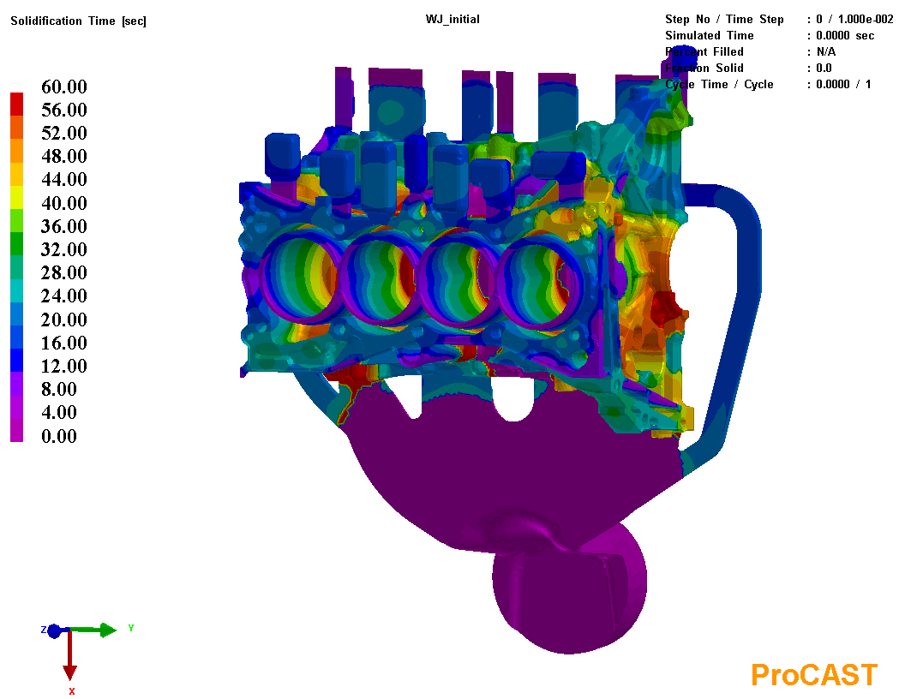
Engine block HPDC simulation
Minimum element size is 2 mm, with 2D elements number 596,146 and 3D ones 8,722,809.
For calculation efficiency, no filling was running, only solidification stage was calculated.
Mesh elements
Solidification time

Slide 2
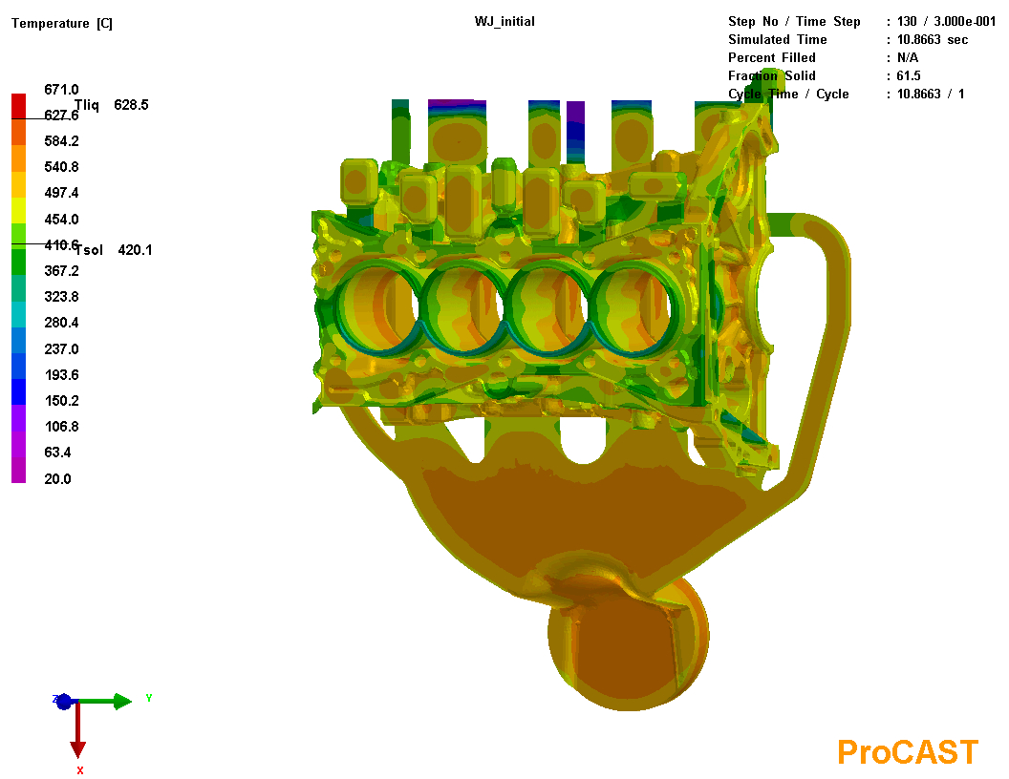
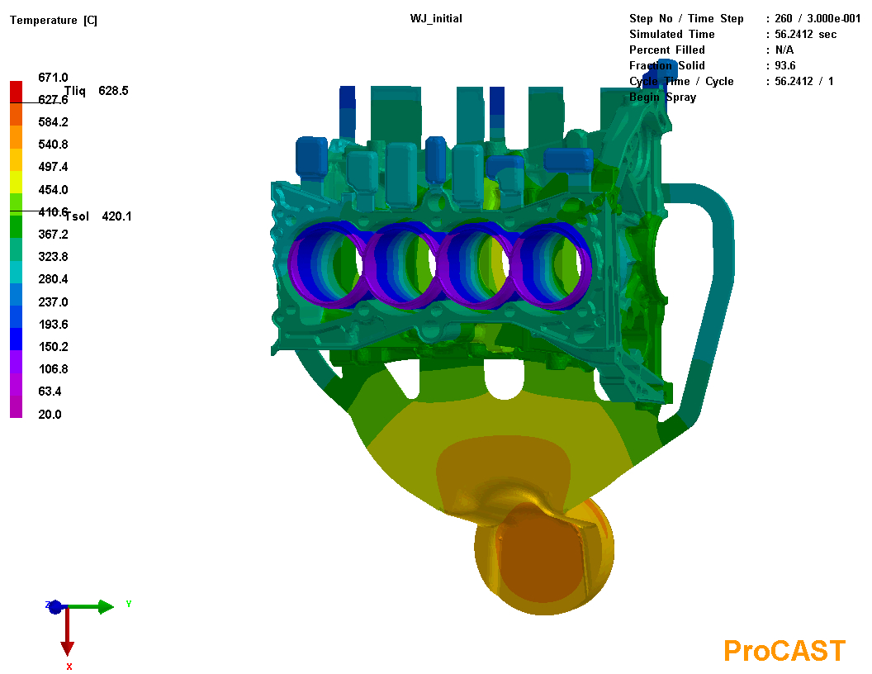
Engine block HPDC simulation
 | Die open (air cooling) | Eject | Lube spray | Air blow | Die close | Cycle total
Time / s | 28 | 34 | 54-58 | / | 87 | 98
Temperature field at t = 10.9 s
Temperature field at t = 56.2 s

Slide 3
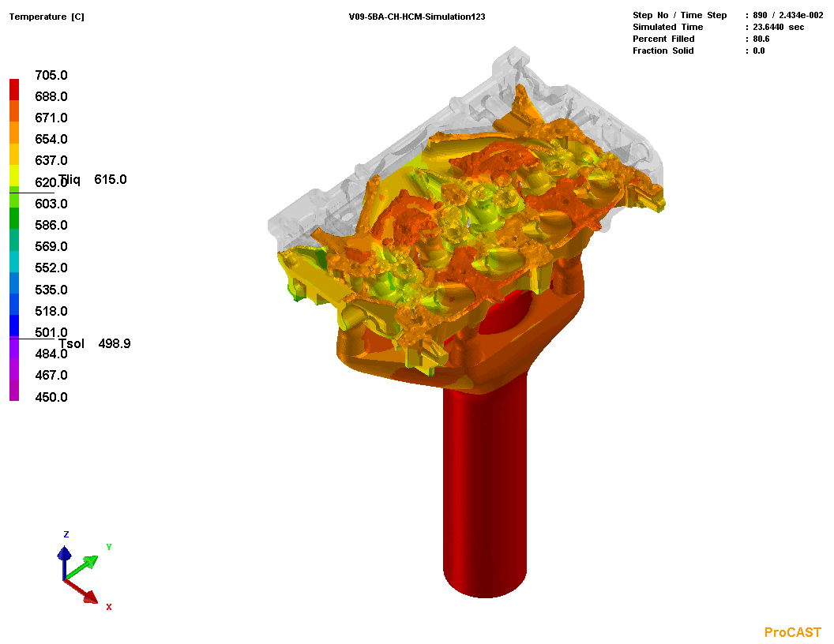
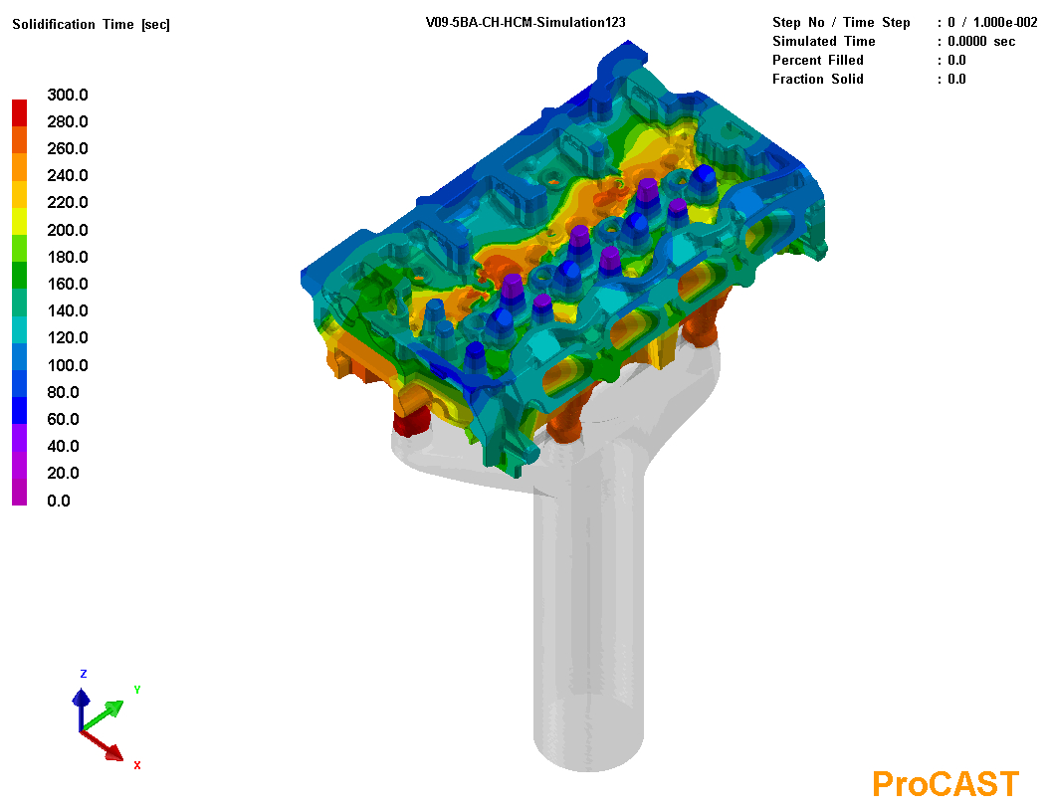
Cylinder head LPDC simulation
Minimum element size is 3 mm, with 2D elements number 507,428 and 3D ones 3,375,045.
Both filling and solidification stages were calculated for 1 cycle.
Temperature field during flow
Solidification time

